Slide 1
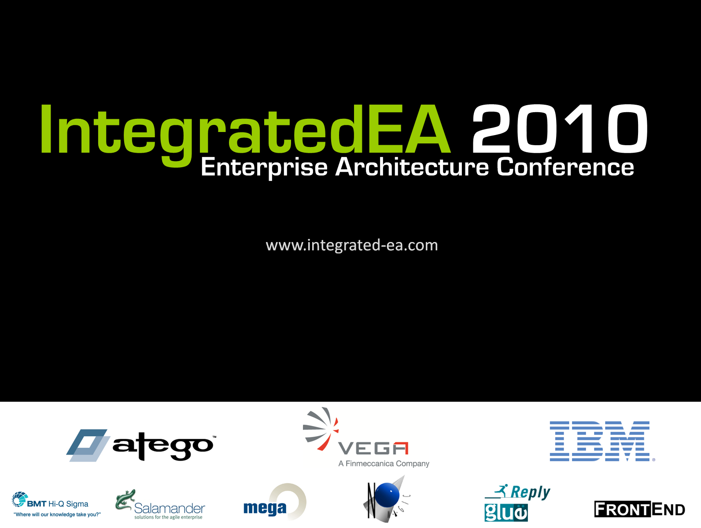

Slide 2
Architecture & Standards Governance in the
Department of Defense
Brian Wilczynski
Director, Architecture, Standards & Interoperability
Office of the DoD Chief Information Officer

Slide 3
Topics
Architecture & Standards Governance Model
Architecture that is “Fit for Purpose”
Governing Architecture Frameworks & Metamodels
Data Exchange Specifications
Turn-over to Dave McDaniel

Slide 4
Governance Bodies
DARS
DISR
ASRG
Approved
Architectures
FAC
ITSC
Approved
IT Standards
ASRG = Architecture & Standards Review Group
FAC = Federated Architecture Committee
ITSC = Information Technology Standards Committee
DARS = DoD Architecture Registry System
DISR = DoD IT Standards Registry

Slide 5
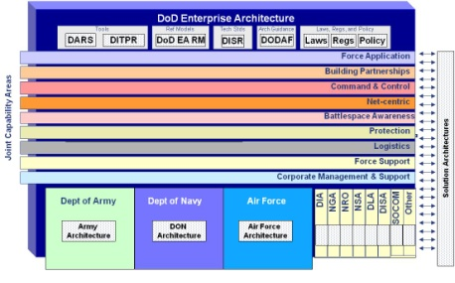
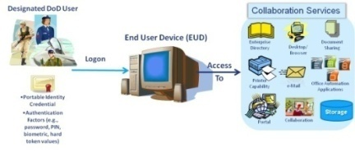
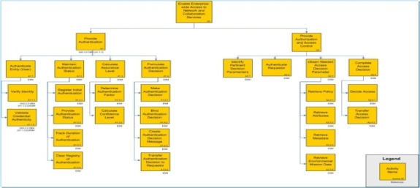
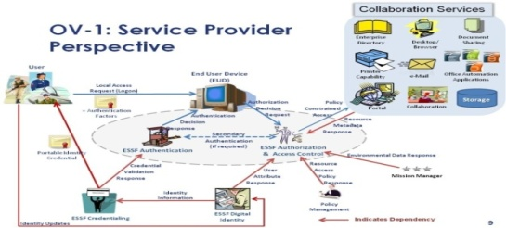
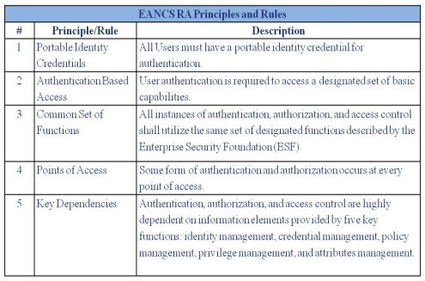
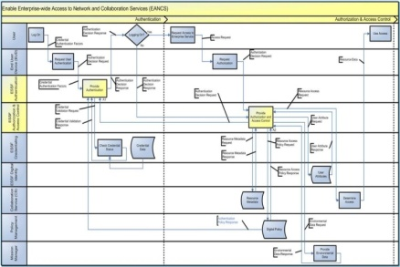
UNCLASSIFIED
“Fit for Purpose” Architecture
Architecture Federation
OV-5a (Activity
Decomposition)
OV-1 (Concept – Consumer & Provider)
EANCS RA Document
Provides Enterprise-Level Guidance for common authentication, authorization and access control.
OV-6c (Event-Trace
Description)
OV-6a (Operational
Rules Model)
StdV-1 (Standards Profile)
Notes:
5

Slide 6
DoDAF v2.0 Viewpoints
Capability Viewpoint
Articulate the capability requirement, delivery timing, and deployed capability
Operational Viewpoint
Articulate operational scenarios, processes, activities & requirements
Project Viewpoint
Describes the relationships between operational and capability requirements and the various projects being implemented; Details dependencies between capability management and the Defense Acquisition System process.
Standards Viewpoint
Articulate applicable Operational, Business, Technical, and Industry policy, standards, guidance, constraints, and forecasts
Data and Information Viewpoint
Articulate the data relationships and alignment structures in the architecture content
All Viewpoint
Overarching aspects of architecture context that relate to all models
Services Viewpoint
Articulate the performers, activities, services, and their exchanges providing for, or supporting, DoD functions
Systems Viewpoint
Articulate the legacy systems or independent systems, their composition, interconnectivity, and context providing for, or supporting, DoD functions
Architecture viewpoints are composed of data that has been organized to facilitate understanding.
Notes:
In DODAF 2.0 we have described an expanded number of viewpoints (categories of models and views expressing differing aspects of a common architecture need) to include those shown on the slide. Some of the viewpoints were introduced in earlier versions of DoDAF, others, such as Project and Capability are new to DoDAF 2.0.
An architecture viewpoint can be displayed in a number of formats, such as dashboards, fusion, textual, composite, or graphs, which represents data and the architecture description which represents an architecture. In DoDAF 2.0, the ability is provided to create an architectural description which can be expressed in many of the same formats normally used for briefing, analysis, and decision-making.
The next few slides present a view of data from an architecture developed for the US Air Force at Arnold Engineering Development Center in Tennessee. This is the Air Force Center for R&D, testing and Analysis of aircraft, engines, and other components. Both Charles and I are using these views today with the permission of the Air Force.
6

Slide 7
DM2 Conceptual Data Model
Vision
Organization
Realizes
Person Type
Location
Desired Effect
Is A
Produces
At
Performer
Capability
Performer
Is A
Performs
Enables
Performed by
System
Activity
Activity
Service
Consumes
Produces
Subject To
Resource
Requires
Conditions
Standards
Which Is
Measures
Projects
Rules
Or
Skills
Information
Materiel
Notes:
The new DoDAF meta-Model is much simpler and easier to understand than the old CADM Model from previous versions of DoDAF. There are twelve data groups, each of which collects some specific type of architecture data.
[Go through groups]
Internal [Project, Goals, Training, skill, education]
Architectural [Rules, measures, Locations, Activities, Performers, Resource Flows, Capability, Services]
Informational [Information and data]
7

Slide 8




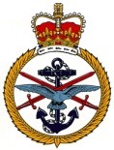




Leveraging a Multi-National Model
http://en.wikipedia.org/wiki/IDEAS_Group
IDEAS:
  Mathematics
    type (~set) theory
    4D mereotopology
  Deals with issues of states, powertypes, measures, space -- what is truly knowable vs. what is assumed
  Separates signs and representations from referents
DM2 domain concepts are extensions to the formal foundation
Rigorously worked-out common patterns are reused:
  Super-subtype, whole-part, temporal whole-part, type-instance, before-after, overlap
  Saved a lot of repetitive work
  Result is higher quality and consistency throughout
Three types of “Things”
Individuals – Things with spatio-temporal extent (not people)
Types – similar to sets
Tuples – ordered relations between Things
Notes:
As we started figuring out relationships, we realized we were doing the same relationships over and over again. Decided to look into leveraging work we had been doing for several years with the international community on a formal .ontology. IDEAS foundation concepts are inherited into all the DM2 concepts. Saved us a lot of work – ontologic free lunch -- and part of the reason why the model is so small to this day -- ~ 300 classes, attributes, and values as compared to CADM’s 16, 000 pieces.
Three types of Things: Types (which are like sets), Tuples (ordered relationships), and Individuals (not persons, but Things that have spatial and temporal extent – spatio-temporal extent.)
mereology is a collection of axiomatic first-order theories dealing with parts and their respective wholes. In contrast to set theory, which takes the set–member relationship as fundamental, the core notion of mereology is the part–whole relationship. Mereology is both an application of predicate logic and a branch of formal ontology.

